Slide 1
Financial literacy
Name – Arif Aggarwal
Roll no.- 102103083
Submitted to – Ms. Lovika

Slide 2
CONTENT
INTRODUCTION
WHERE DOES YOUR MONEY COME FROM?
WHERE DOES YOUR MONEY GO?
FINANCIAL PLANNING
INVESTMENT
SIMPLE WAYS OF INVESTMENT

Slide 3
INTRODUCTION
Financial literacy refers to the ability to understand and apply different financial skills effectively, including personal financial management, budgeting , saving and investing.
Financial literacy makes individuals become self-sufficient, so that financial stability can be accomplished.

Slide 4


WHERE DOES your MONEY COME FROM?
Cashflow Quadrant(Four ways that money may come your way)
RAT RACE
FAST TRACK

Slide 5
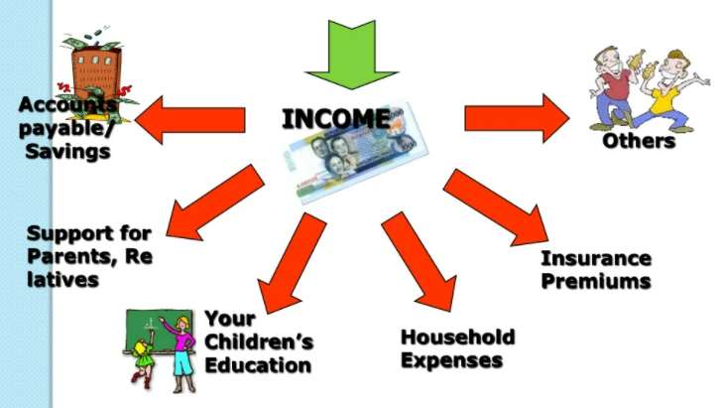
WHERE DOES YOUR MONEY GO ?

Slide 6

FINANCIAL PLANNING
BENEFITS OF HAVING A FINANCIAL PLAN:-
It can help you avoid mistakes/sidetrack
Helps You make smarter
Can insulate you from the turbulence in the economy
Makes money work for you!

Slide 7
INVESTMENT
Investment is the commitment of funds made in expectation of some positive rate of return.
Invest and Diversify Invest
Make your money grow . Invest your savings in money making-assets.
Make Your Money Work For You

Slide 8
simple ways of investment
Invest in debt
Lending Investments: Gov’t/Corporate bonds or Banks etc.
Real Estate
Stock Market
Mutual Funds
Engage in Business

Slide 9
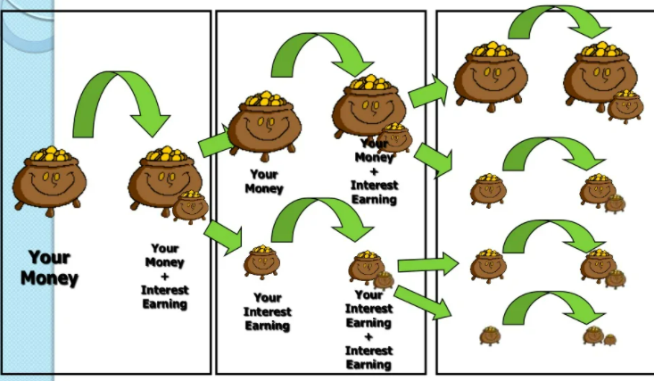
Trust the power of time and compounding
PERIOD 1
PERIOD 2
PERIOD 3

Slide 10
Rule of 72
The rule of 72 is a simple way to determine how long an investment will take to double given a fixed annual rate of interest.
Time for investment to double = 72
Rate of Return

Slide 11
references
RICH DAD’S CASHFLOW QUADRANT BY ROBERT T. KIYOSKI
cleartax.in
www.slideshare.net

Slide 12
Thank you

